Slide 1
Tides do weird things!
Don’t assume it will be the same next time!

Slide 2
What is not a tide?
Tidal wave is not a Tsunami or a swell
Tsunamis are caused by factors outside of the astrological tidal movement, e.g. slumping / earthquakes
Swell is due to weather patterns

Slide 3
What makes a tide?
Basic understanding is sun and moon rotation
Spring and Neap – two constituent factors
Weather bureau (NOAA & BOM) typically use up to 37 constituents to calculate tides.
But in Anchorage Alaska and Philadelphia it takes over 100 factors to calculate their tides.
Neil deGrasse Tyson: Tide doesn't come to us, we rotate through it!

Slide 4
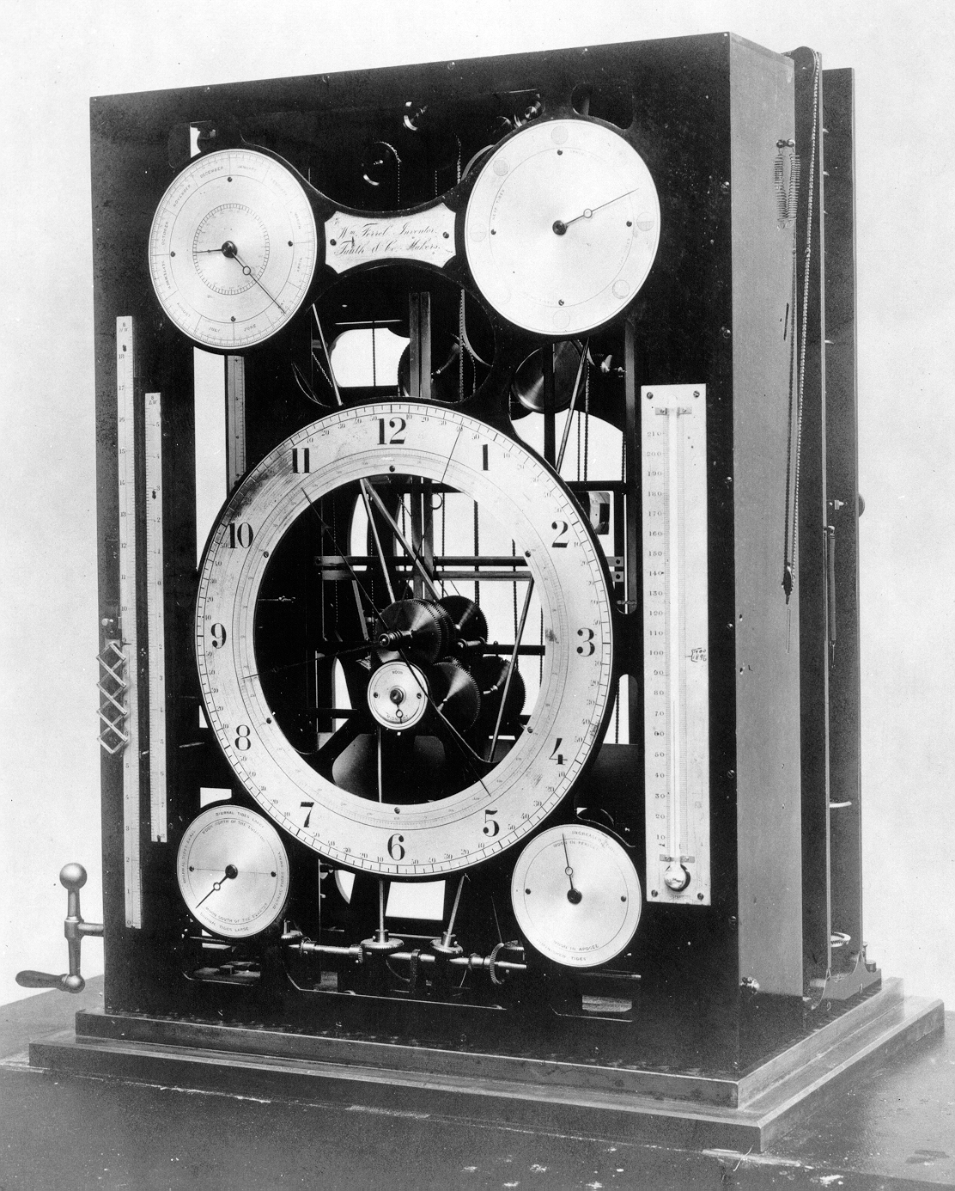
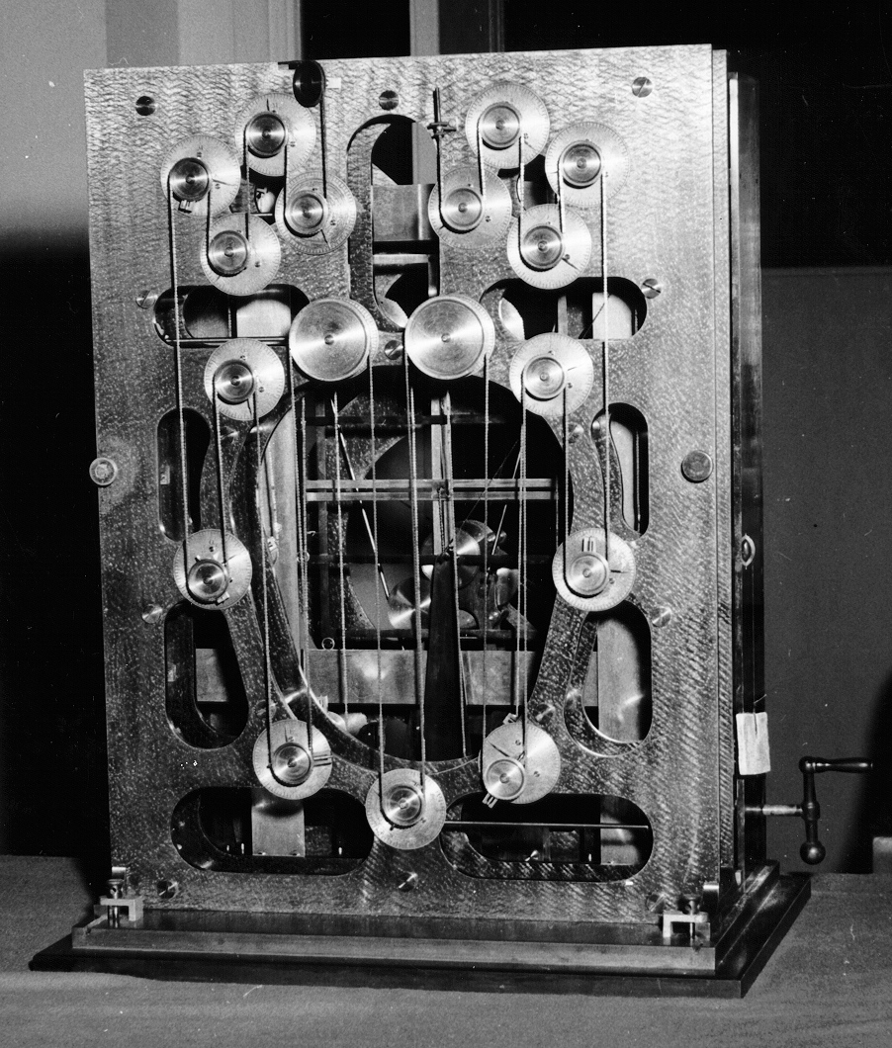
William Ferrel Tide Machine (1885) used 19 constituents to predict tides.
By 1912 the Harris & Fisher machine used 37 constituents.
It takes 19 years to run a full cycle of the data.

Slide 5
Tidal factors – the 2 basics
Moon
Sun (Sun tide = Moon tide X 46%)
Relative alignment of sun and moon – Spring & Neap tides
  Forces are added during Spring Tides
  Forces are adjacent during Neap tides

Slide 6
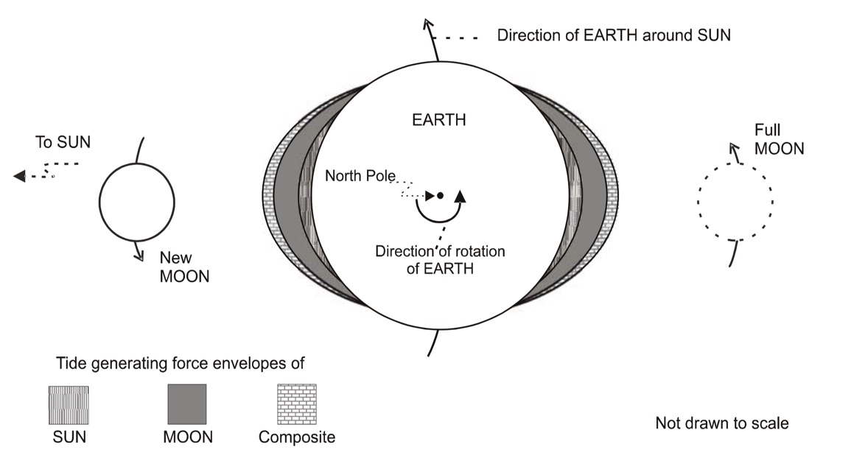
Spring and Neap tides

Slide 7
Spring and Neap tides
Port Philip seems to be not-quite-right for our Neap when compared to Perth

Slide 8
Gravity over distance
Distance of moon from earth – elliptical orbit once per month
  Once per month moon is closer - greater influence on tides (perigee)
  Once per month moon is further - smaller lunar tides – (apogee)
Distance of earth from Sun – elliptical orbit once per year
  Due to orbital eccentricity the earth is 5% closer to the sun in the southern hemisphere summer than northern summer – hotter
    Closest to Sun in the southern summer (January 2)
    Furthest from Sun in northern summer (July 2)
    Southern summers are hotter than northern summers
    Gravitational pull from the sun is proportionally greater in our summer
Don't confuse distance to the sun/moon with angle
  Angle is called Declination – see next slide

Slide 9
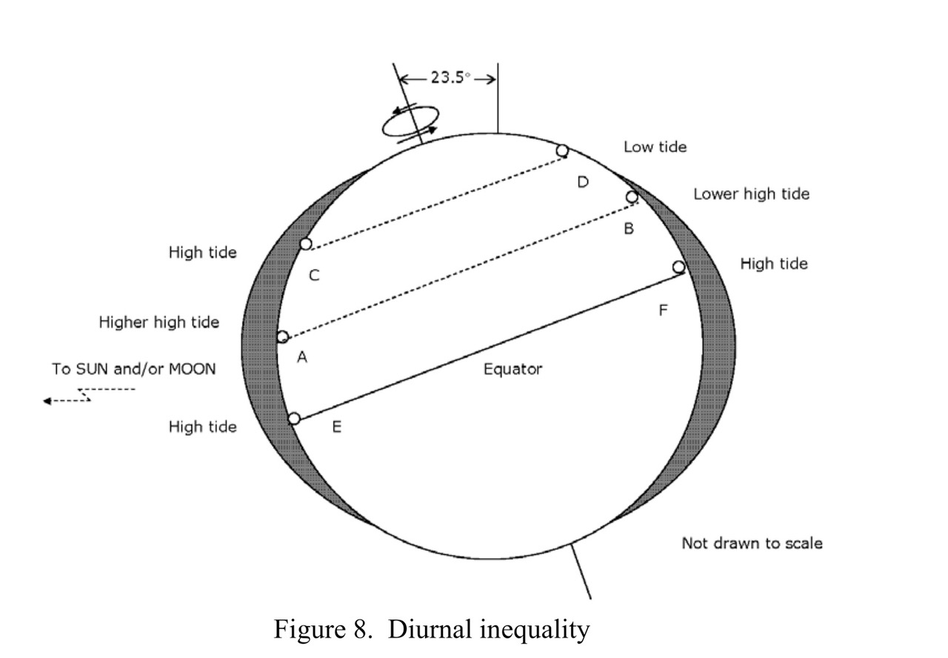
Missing tides?
Diurnal inequality
  Earth rotates at an angle to the moon and sun
  One tide per day is can be closer to the moon alignment than the other
  Extreme diurnal inequality can cause a diurnal tide (one tide per day or a missing tide)

Slide 10
Solar Seasons (angle to the sun)
Solar Declination
  December 22nd is when the southern hemisphere is at the closest angle to the Sun.
  Solar plane is at an angle of 23 degrees to the equator
  Don’t confuse proximity to the sun with angle to the sun – both occur on an annual cycle – 11 days apart

Slide 11
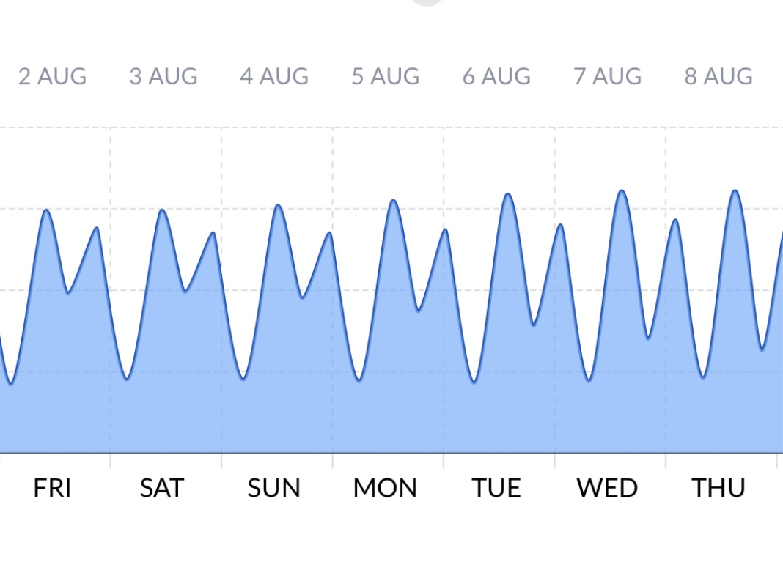
Lunar seasons (angle to the moon)
  Angle changes over an 18.6 year cycle
  Angle of the moon orbit is 5 degrees to solar plane.
  Therefore the lunar orbit can range from 18 to 28 degrees throughout the 18.6 year cycle (23 +/- 5)
  This can have a big effect on Diurnal inequality

Slide 12
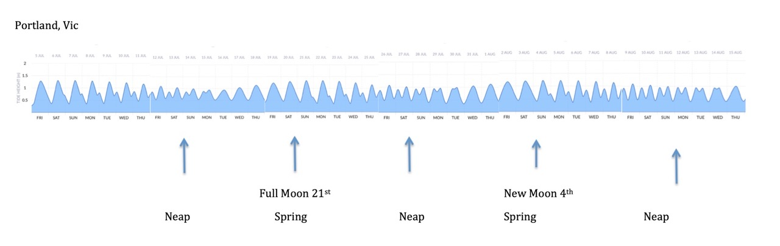
Diurnal, Semidiurnal, Mixed, None
Diurnal – One tide/day are rare
Semidiurnal – Two highs / lows per day
Mixed – Higher high and lower low
No tide – Amphidromic points

Slide 13
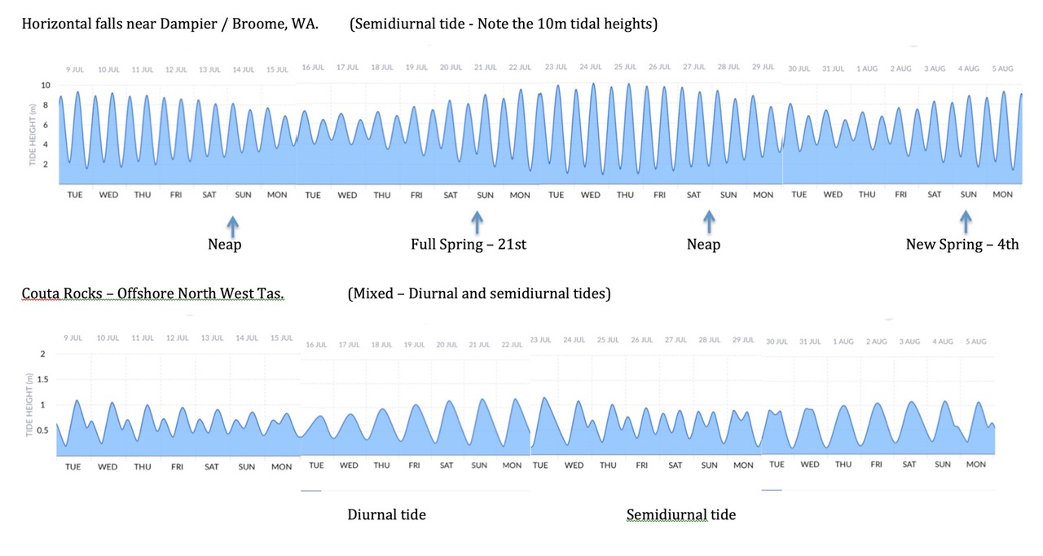

Slide 14
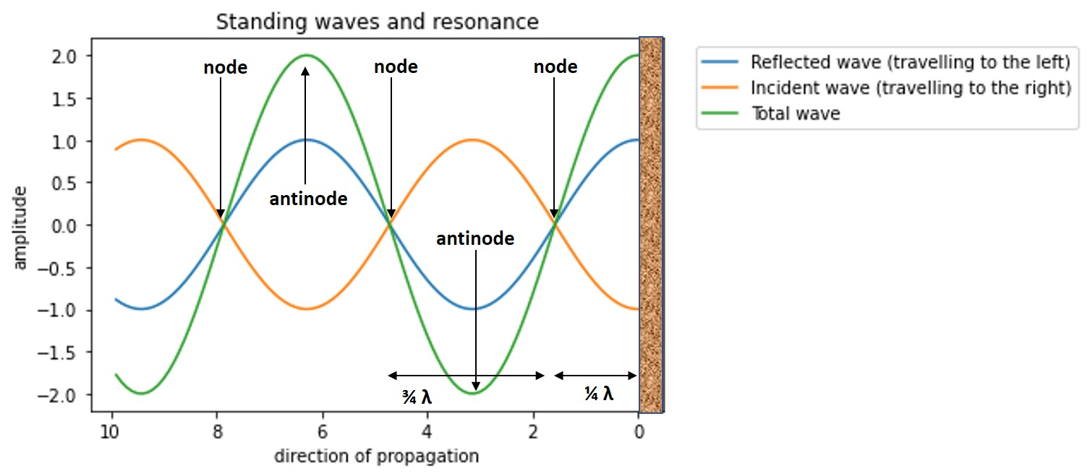
Amphidromic points (no tide)
Reflected wave patterns balance out and no net change is detected.
A rocking oscillation around a no-tide point, usually near the center
Tahiti, the Galapagos and north of PNG have almost no tidal movement

Slide 15
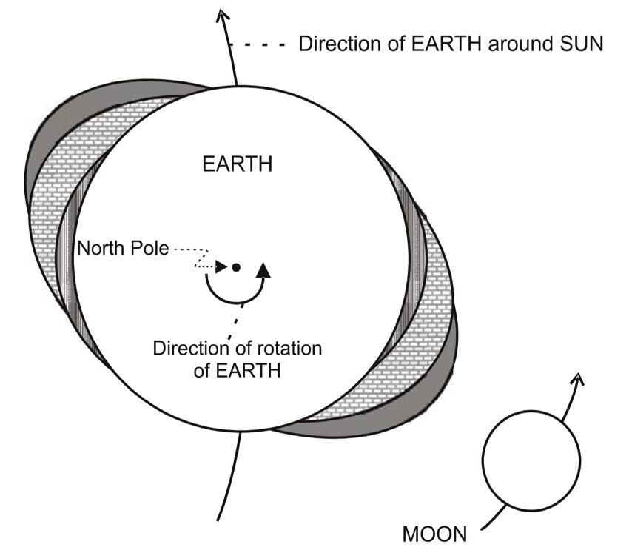
Lagging & Priming
Lagging – In the first and third quarter the tides times are retarded, in the second and fourth they are advanced

Slide 16
Coriolis effect
  Clockwise movement within a bay or estuary in the Southern hemisphere
  Looking into a bay from the heads, the incoming tide will slope up to the left.
  The outgoing tide will slope upwards to the right
  This causes a clockwise whirlpool effect across the body of water
  There will be a slightly greater tidal range on the left side of the bay

Slide 17
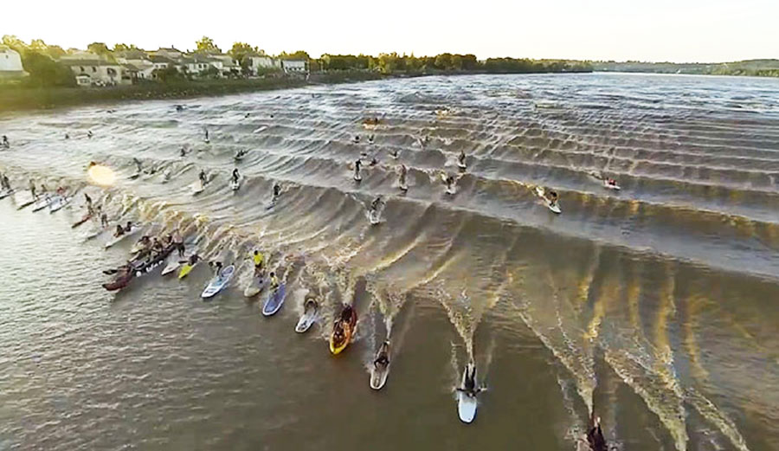
Tidal Bores
  Gently sloping river bed or estuary
  Incoming tide reverses the energy of the outgoing river causing a steep continuous wave
  River Trent England, Cook Inlet Alaska, Chainman's Hat in Port Philip Bay.

Slide 18
Sea level rise
  As the water depth increases, the wavelength of the tidal wave will increase.
  Effect of sea level rise will be more pronounced in coastal regions,
    Relative change in water depth will be larger compared to the relative change in open ocean.
  The amount of sea-level rise differs per region.
  Sea-level rise results in less bottom friction and therefore less energy dissipation.

Slide 19
Calibration of tides
Local adjustment for difference between calculated tide and actual tide
Adjusting factor must be recalibrated after dredging, ocean slumping, earthquakes
Climate change
    1990’s averaged around 2mm per year
    Currently 4-5mm per year
    Northern Australia 6mm per year

Slide 20
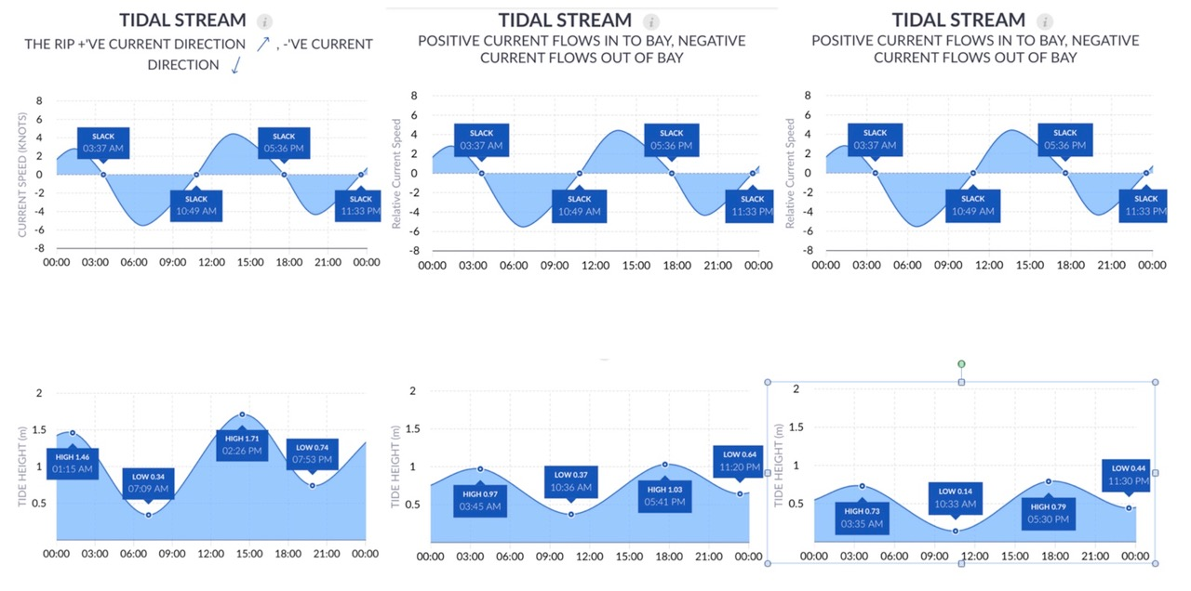
Tide charts for Port Philip Bay
Port Philip Heads South Channel Fort South Channel Pile

