Slide 1
Dive Computers
How do we use them?
Terri Allen, tec and rec diver, cavediver, backmount/sidemount

Slide 2
Dive computer survey
Brands and models
38 responses in total
23 Shearwater users. Mixture of Perdix, Teric and Peregrine
9 Suunto D5, Eon, Vyper, Zoop, Ocean
5 Scubapro/Galileo/Aladdin Pro. Luna, G2
1 Aqualung i300c
1 Apple Ultra2 (watch)

Slide 3
How many dives? What types?
0-100 dives
Types of diving
29 divers use for recreational
Other 10 also use for Tec, cave, rebreather

Slide 4
What settings do you use?
Wide responses (Changes, vs uses)
Set as purchased, no need to change, can’t change ye olde Aladdin Pro :)
Air and nitrox
NDL
Plain Jane
Nitrox
Conservative setting
OC tec adjust gradient factors
If solo more aggressive
Nitrox, deco, GFs
Tank pressure

Slide 5
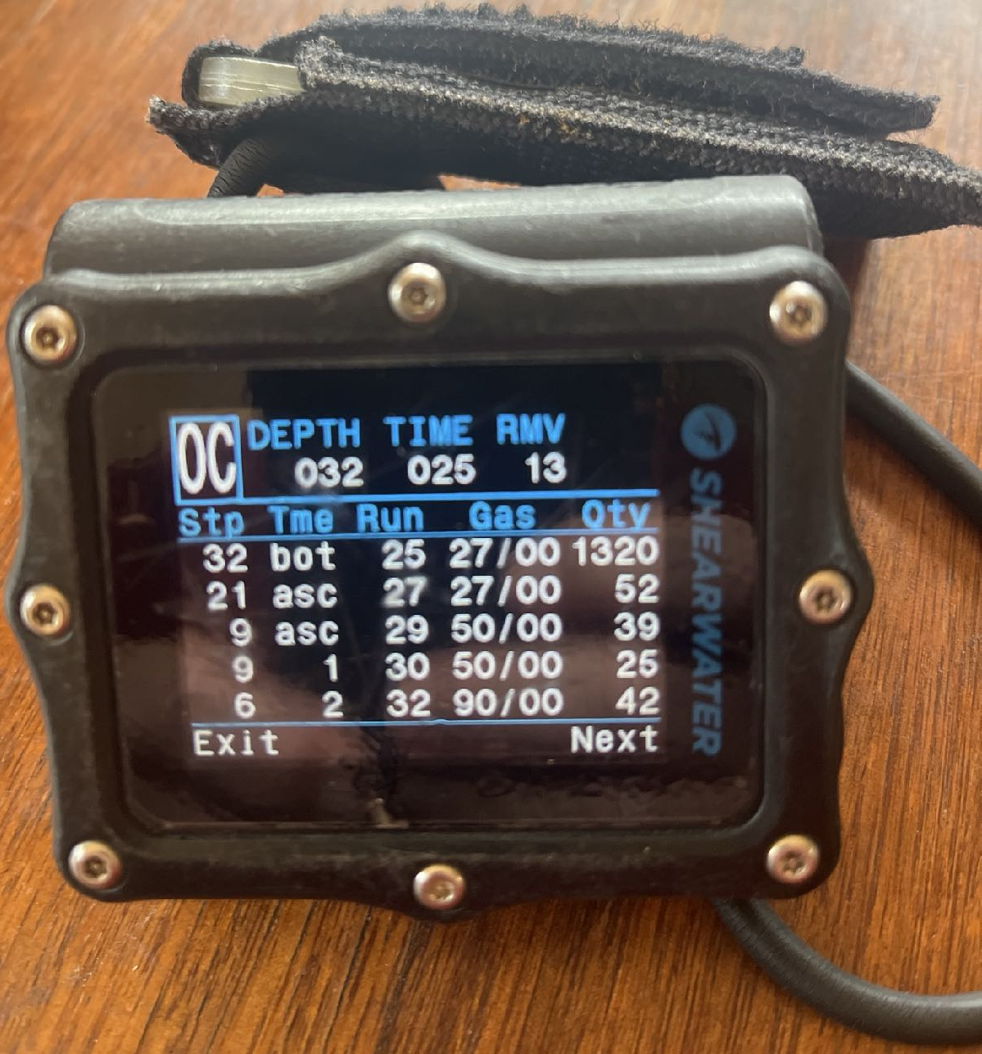
Planning dives, do you use your computer?
24 responses NO do not use computer to preplan dive
10 responses YES do preplan using dive computer

Slide 6
Software? Planning versus logging?
Mike to discuss
Responses:
“There are apps?”
Shearwater cloud
Multi Deco
Subsurface
Suunto app or android
Uwatec Datatrack
Zip
DiverLog+

Slide 7
What do you like about your computer?
Easy to read common response
Colour screen
Like it in console not wrist
Like air integration
It looks after me
Simplicity
Shows SAC
Good battery life, easy to change
Great Tec features, can change screen to show what I want
Customer service
Good as a cak up

Slide 8
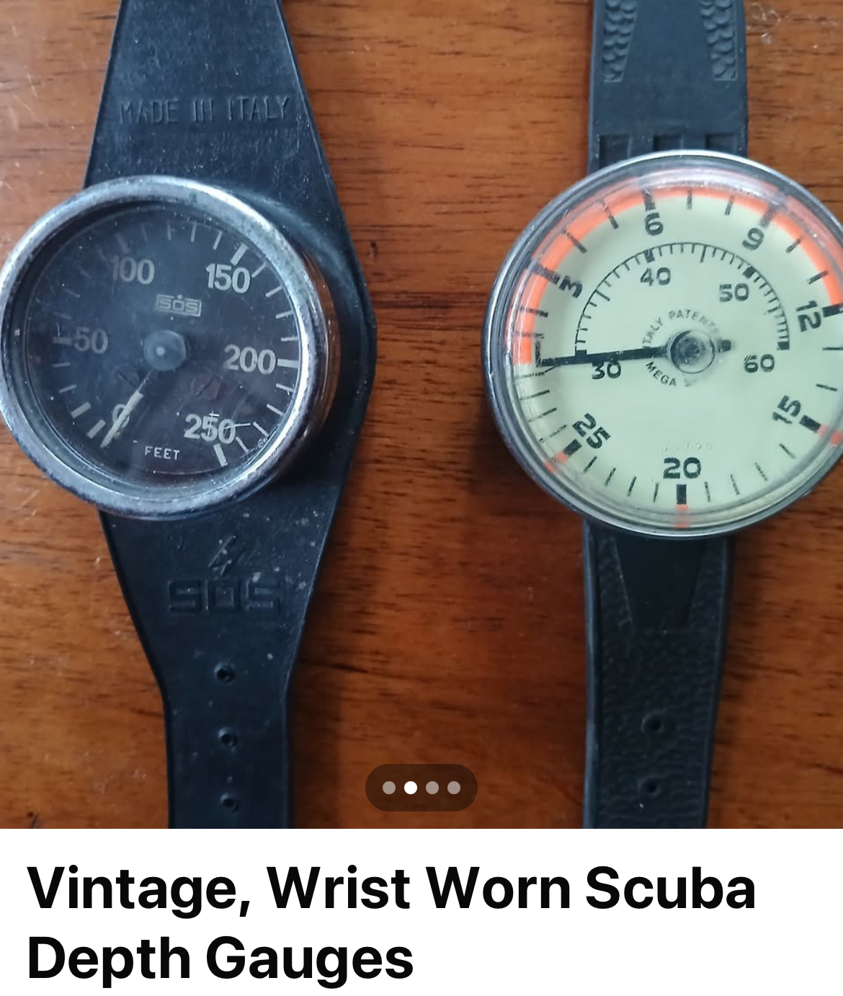
Extra info to share
My point of view
Get to know your computer
Read the manual!
Look at dive simulations on the web, YouTube
What happens when I go in to deco?
Safety stops after clearing deco and during multi dive/multi day trips
NITROX!
Where should I wear it? Left arm, right arm or console?
Bungy versus strap?
Back up computer or bottom timer?
Caption

Slide 9
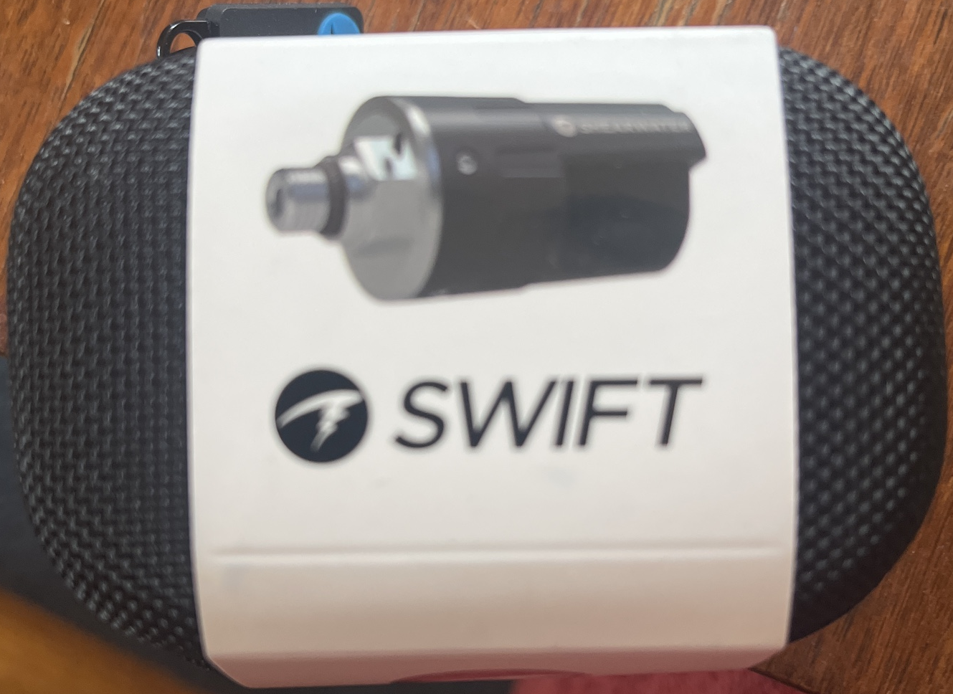
Dive computers transmitters/air integration
Pros and cons
Pros
Easy to see gas remaining
Some can calculate SAC, GTR
Great for side mounting and stages
Less failure points
Cons
Expensive
Lost comms, crosstalk interference?
Battery
More prone to possible damage?

Slide 10
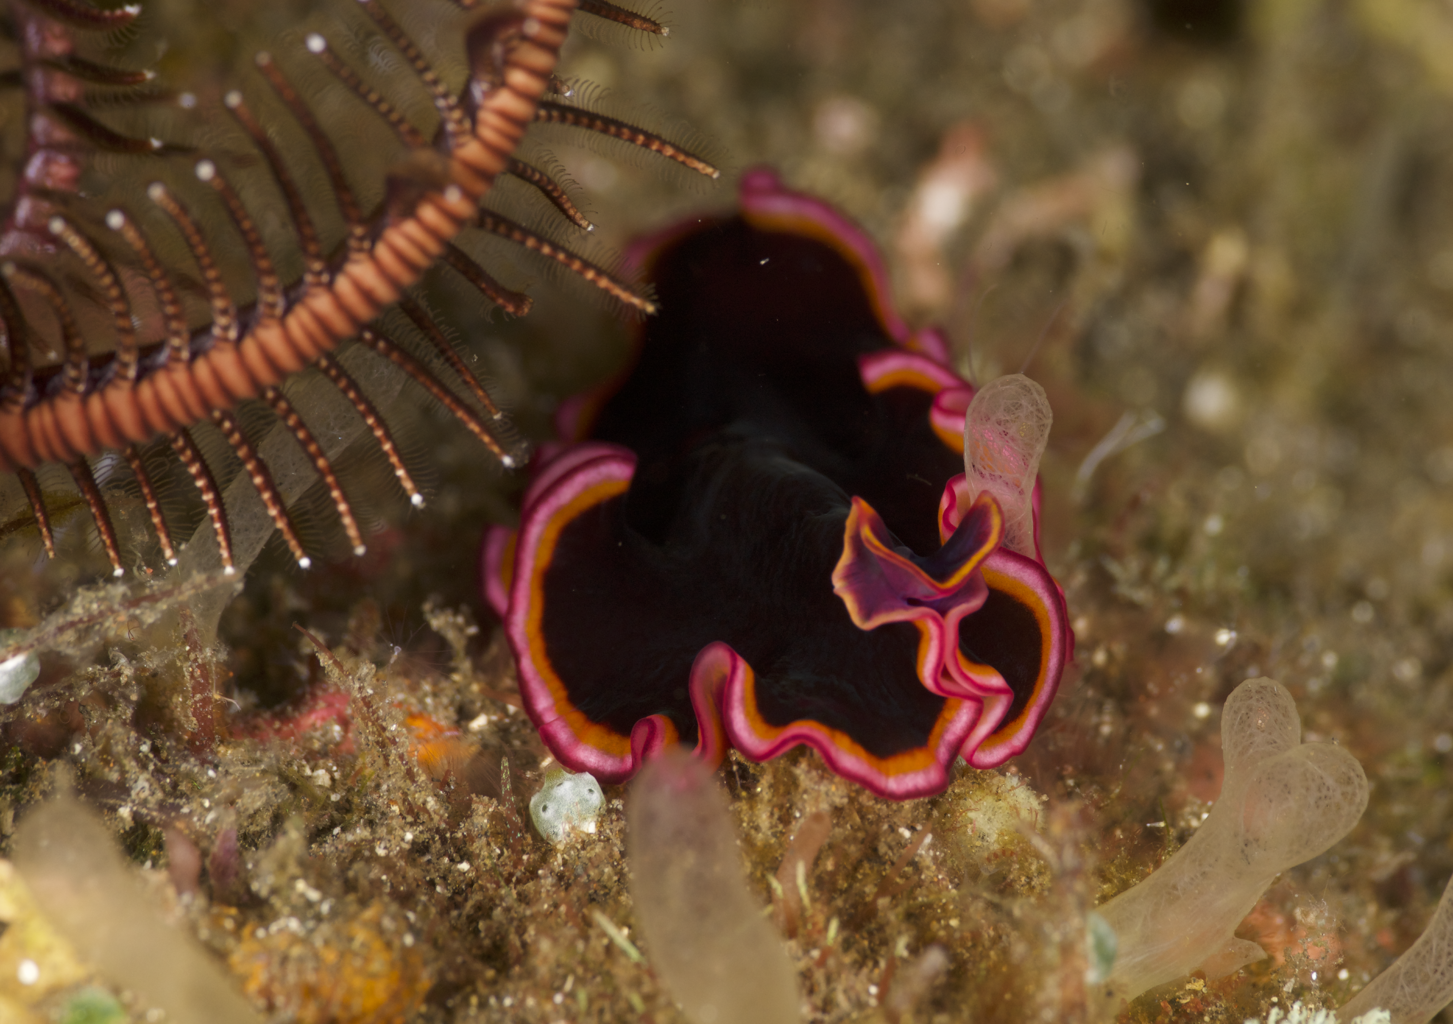
Discussion?
Caption

